Slide 1
Intro, Logistics and OpenROAD
Prof. Andrew Kahng

Slide 2
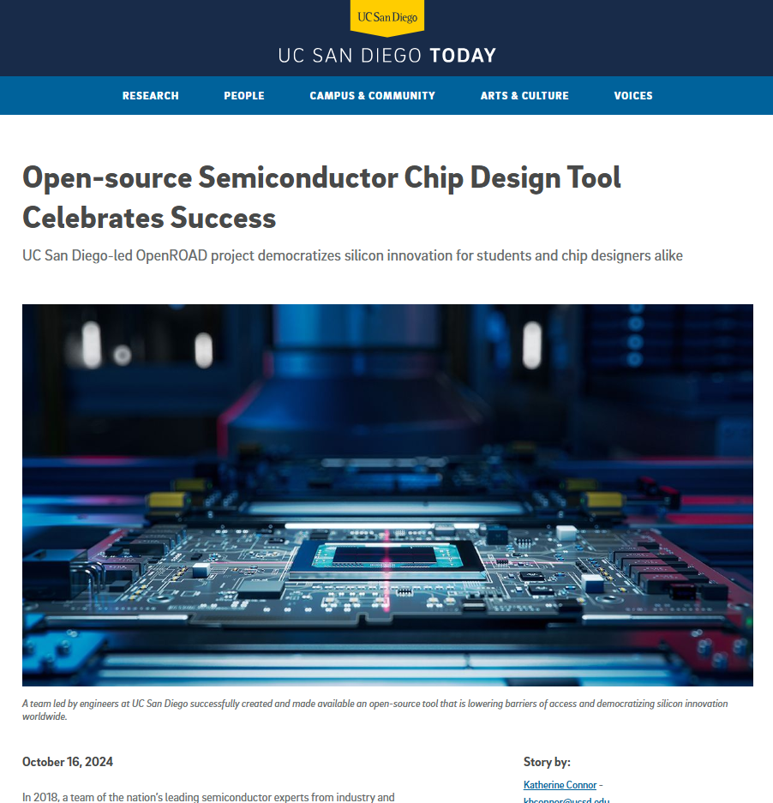
ECE 260C A00, SP25: “VLSI Special Topics”
This version of 260C will explore emerging open-source VLSI (digital, RTL-to-GDS) implementation software, giving you a chance to understand the internals of the tools you use.
Course materials will center on the OpenROAD tool and the IHP130 open-source PDK.
Notes:
Developed at UCSD

Slide 3
Scope
Explore the expanding field of Open-Source VLSI CAD Software
Learn how to use OpenROAD and Yosys as an alternative to commercial software like Cadence Innovus
Learn how to apply complex scripting to achieve better results
Take advantage of open-source by making deeper in-source changes
Build design space exploration flows commonly demanded in industry
Understand the internals and algorithms that drive implementation
Apply learned methodologies in the context of System-on-Chip design
Note: This is a brand-new class (!) with assumed prerequisites (!)

Slide 4
Logistics
Lectures are Tues/Thurs from 5:00 pm to 6:20 pm in Center Hall 216
Attendance is Mandatory. At the end of the lecture, you must complete Lecture Participation in Canvas > Quizzes. This is 20% of your grade. Regrades available.
The topics and lecturer for each lecture can be seen on the Course Schedule
There are 5 labs and a Final Project
Labs are 60% of your grade (12% each)
The Final Project is 20% of your grade.
Stay up to date on the Schedule and check Canvas Announcements !!!
Canvas Home > Course Schedule
Office Hours are also on Canvas
Course staff: Andrew Kahng (instructor), Bodhi Pramanik (TA), Davit Markarian (volunteer)

Slide 5
Logistics Cont’d
Labs are assigned at the end of lecture – Lab 0 today
Check the Course Schedule for due dates.
On the due date, they can be turned in as late as 2:59 AM with no penalty. After, no submissions will be accepted.
Regrades will be available.
Your Final Project will be assigned in Week 5
In a small team, you will improve upon an existing SoC
More details will follow when assigned.
This course has no final exam
Instead, the Final Project is due on the assigned exam date at midnight.
Please review the Syllabus on Canvas

Slide 6
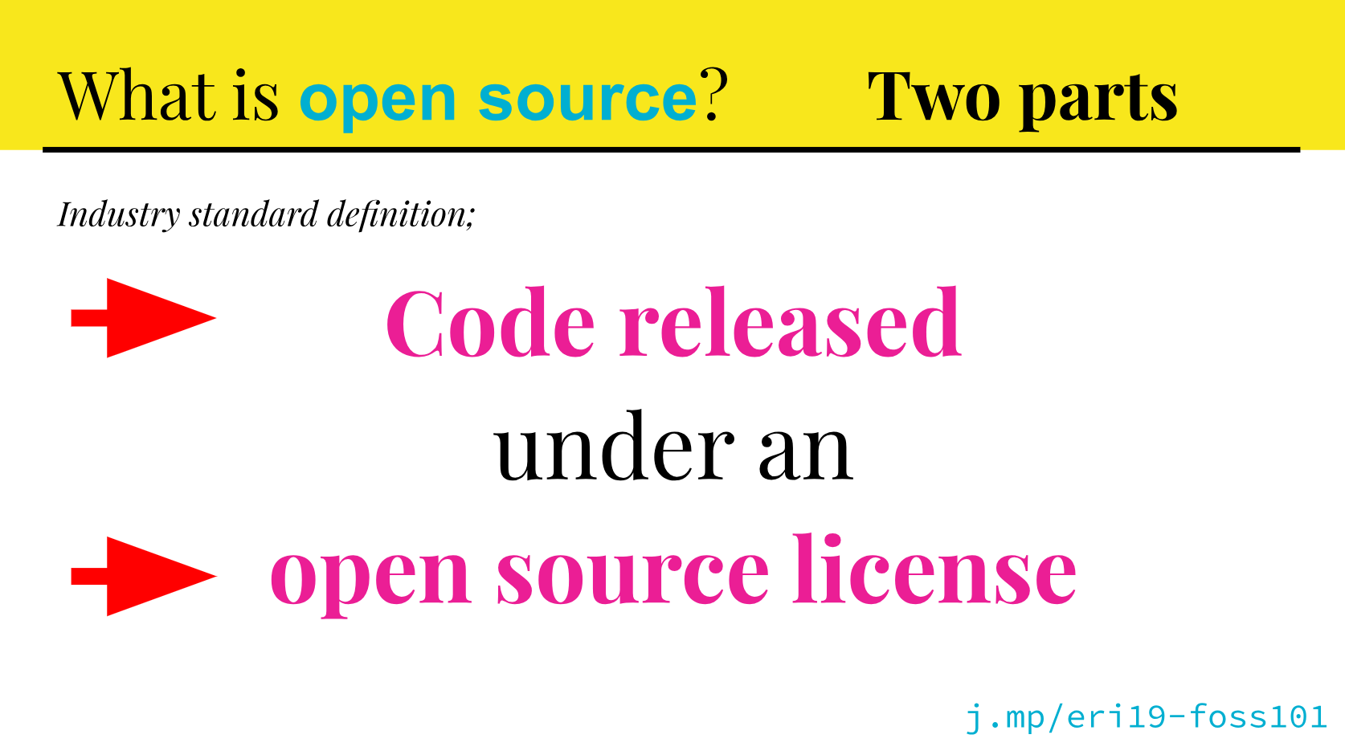
What is Open-Source EDA ?
EDA tools that satisfy the definition of open source
Tim Ansell, Open Source 101, 2019
Freely usable, freely modifiable, and shareable
License permits free redistribution, creation of derived works, and use by anyone for any purpose, in a technology-neutral manner
Transformative! → Linux, Android, RISC-V, TensorFlow, …
Permissive licenses: BSD, MIT, Apache2.0 …
Share-alike / “copyleft”: GPL-2 or GPL-3 …

Slide 7
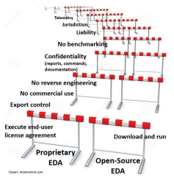
Closed-Source EDA (e.g., in ECE 260B)
Can you share your Tcl script with another user?
Can you share code or write a tool that reads the same command syntax?
Can you share the tool’s output (gds, logfile, …)
Can you compare it with another tool (“benchmarking”)?
Can you use the tool output to make a chip startup?
Can you share any of the tool’s documentation?
Can you upload the user guide or a logfile into ChatGPT?
…
“A Mixed Open-Source and Proprietary EDA Commons for Education and Prototyping”, ICCAD-2022. (.pdf)
(No! See the EULA that your university executed.)

Slide 8
About OpenROAD
“Foundations and Realization of Open, Accessible Design”
Notes:
Starting from its title, this project aims at Foundations and
[CLICK] Realization of Open, Accessible Design. That’s the ROAD part that takes us all forward.
In the first part of this talk, I’ll start with background about OpenROAD -- and how it has become a disruptive enabler of semiconductor design innovation and education.

Slide 9
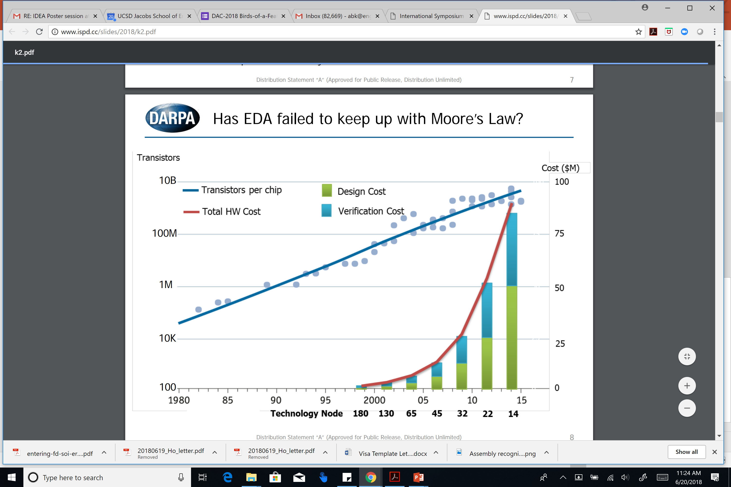
The Crisis of Hardware Design
ASIC design in advanced nodes: barriers of Cost, Expertise, Risk
Innovators can’t evaluate PPAC metrics of their design ideas
A. Olofsson, ISPD-2018
Notes:
For some years, we’ve seen a growing crisis of design. Taking innovative ideas into silicon runs into BARRIERS of Cost, Expertise, and Risk.
[CLICK] The cost of a WAFER pretty much always ends up at nickels or dimes per square millimeter – but THIS red curve here says that the cost of DESIGNING that square millimeter is OUT OF CONTROL.
[CLICK] And innovators can’t tell how good their designs are, in terms of the metrics they care about: size-weight-and-power, or power-performance-area. It’s just too difficult for them to take their ideas into silicon.

Slide 10
ASIC Design with Proprietary EDA: Need $$$, Experts
Very sophisticated tools with 1000’s of commands
Tool supplier focus: performance, power, area
Large teams of expert users, many manual steps
Long project schedules
Significant project risks
Notes:
How DO designers TODAY transform a piece of RTL code into a manufacturable chip layout?
Well, commercial EDA vendors offer extremely sophisticated tools that have thousands of commands. These tools cost six or seven figures per license because they enable bleeding-edge customers to squeeze every last bit of performance, power efficiency and area density out of a foundry’s technology.
[CLICK] But the tools are difficult to master. You need expert users who perform many manual steps. And there is schedule cost and risk.
Which is the crisis of hardware design that the DARPA Electronics Resurgence Initiative – and the broader semiconductor industry – have been trying to solve.

Slide 11
OpenROAD: June 2018 – December 2023
“Foundations and Realization of Open, Accessible Design”
Funded by U.S. DARPA as part of the Electronics Resurgence Initiative (ERI). (UCSD = prime contractor)
Mission: Democratize IC Design, Boost HW & EDA Innovation
Revitalize EDA
Contract: Deliver an Open-Source, RTL-to-GDS EDA system
24-hour, no-human-in-loop, tapeout-clean layout in FinFET nodes
https://precisioninno.com/
Notes:
OpenROAD was launched in June 2018 as part of the DARPA Electronics Resurgence Initiative.
“ROAD” stands for Realization of Open, Accessible Design. UCSD was the prime contractor
[CLICK] The OpenROAD mission is to democratize IC design, and to boost both hardware and EDA innovation at scale.
Our contract is to deliver a tool that produces RTL-to-tapeout-clean GDS, in foundry FinFET nodes, in 24 hours, with no human in the loop. Oh – and in permissive open source.
[CLICK] We put together a great team of universities plus Qualcomm and Arm.
[CLICK] Since 2020, a company called Precision Innovations, Inc has driven R&D and especially the support and outreach that the project also demands.
And we’ve received major support from Google and from several commercial engagements.

Slide 12
OpenROAD: No Humans, 24 Hours
FOCUS: Ease of use and runtime
Directly attack the crises of design and innovation
Schedule barrier: RTL-to-GDS in 24 hours
Expertise barrier: No-human-in-loop, tapeout GDS
Cost barrier: Open source (and, runs in 24 hours)
Unleash system innovation and design innovation
Enable tool customization to system, application needs
Notes:
Unlike commercial EDA, OpenROAD focuses on ease of use and runtime.
[CLICK] OpenROAD DIRECTLY attacks the crisis of design AND the crisis of innovation.
It runs in 24 hours. It’s a no-human-in-the-loop tool that outputs design-rule clean layout. And it’s free open source.
[CLICK] Why does this matter? Because it unblocks system ideation and design space exploration – friction-free, with almost zero overheads. And because it’s open source, it’s agile, transparent and customizable as well. You can teach or learn VLSI CAD algorithms, or digital IC implementation, with today’s OpenROAD.

Slide 13
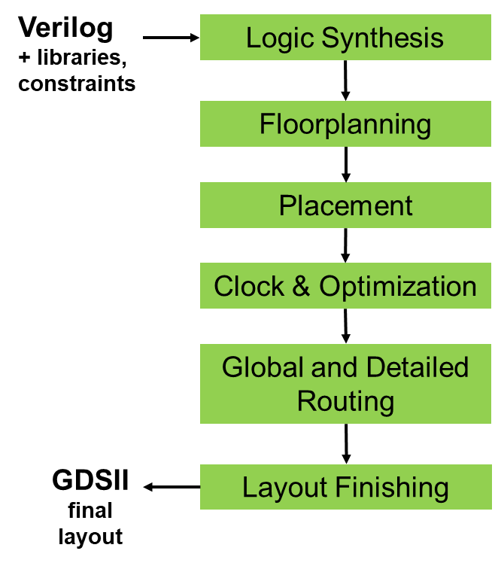
RTL-to-GDS Chip Implementation Flow
Notes:
The “RTL-to-GDS” chip implementation flow starts with logic synthesis and ends with a GDSII tapeout database. Let’s take a look at a few pictures from the physical part of the flow – where a gate-level netlist comes in from Logic Synthesis, and it first goes into floorplanning.

Slide 14

IO Placement (Example: foundry 12nm RISC core, “coyote”)
Notes:
The floorplanning step starts off with a die area and any given I/Os – what you see in red along the top edge. Here, I’ll have a running example of a RISC-V RocketChip core, called Coyote, in a foundry 12nm enablement.

Slide 15
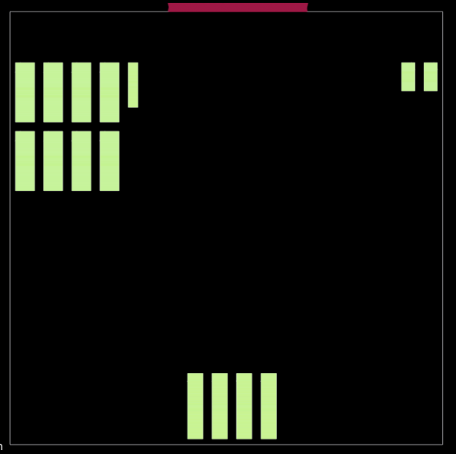
Macro Placement
Notes:
Then, macro blocks – like SRAMs or Register Files – are placed automatically.

Slide 16
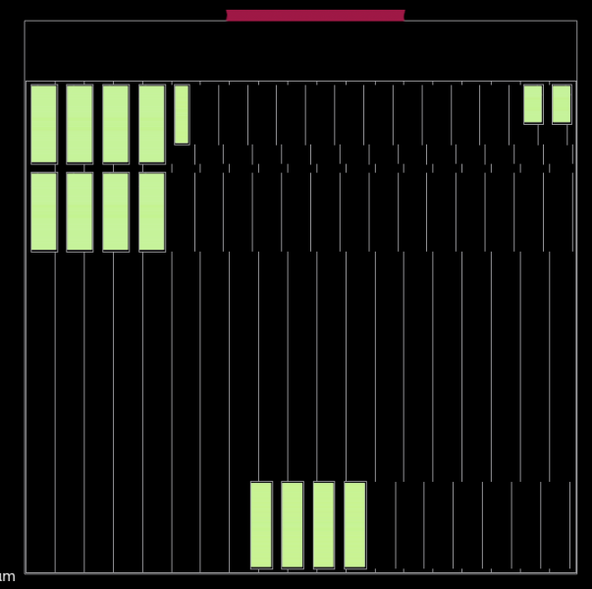
Tapcell (Well Tap) Insertion
Notes:
To avoid latch-up in CMOS, there are rules for well tapcells --- for example, a rule that no device can be more than, say, 25 microns from the nearest tapcell. So the tool inserts tapcells as shown here.

Slide 17
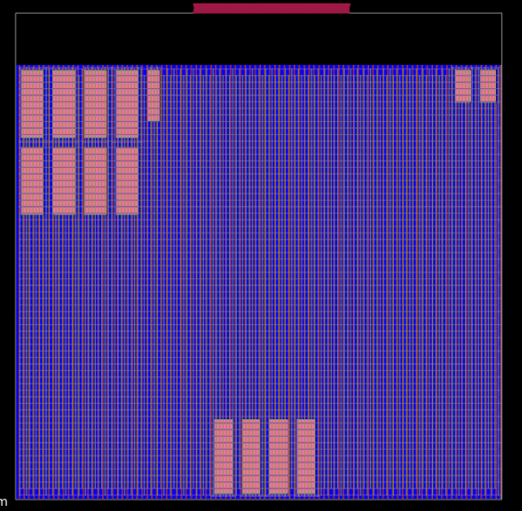
Power Delivery Network
Notes:
Then there’s power delivery network creation, which delivers power and ground to the standard-cell regions in BLUE, and in a different way to the pink memories, because their power and ground pins might be up around Metal-4.

Slide 18
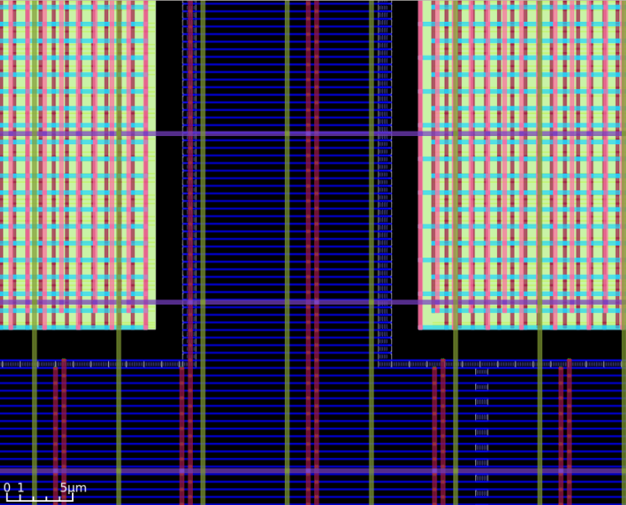
Power Delivery Network – Zoom-In
Notes:
If we zoom in, we can see the horizontal power/ground rails for standard cells in blue, and then the power stripes forming a mesh --- red, purple, olive, and so on --- through which the VDD and VSS are brought to the devices. So already we’ve seen floorplan definition, macro placement, tapcell insertion, and power delivery network creation in “floorplanning. Which is why there still aren’t automatic floorplanners in the commercial world.

Slide 19
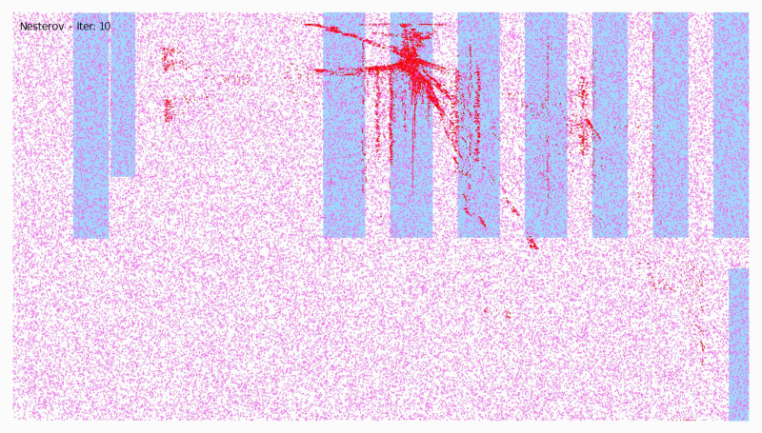
Global Placement
Notes:
After floorplanning, there is placement. What you see here is OpenROAD’s GLOBAL placement engine called RePlAce, which is a routability- and timing-aware analytic placer that uses an “electrostatics” analogy and an efficient numerical optimization. In the fourth talk of this session, Professor David Pan will show his work with NVIDIA, called DREAMPlace, which can speed up this algorithm by 40x on GPU hardware.
Now coming back to our running example of the RocketChip core, global placement produces

Slide 20
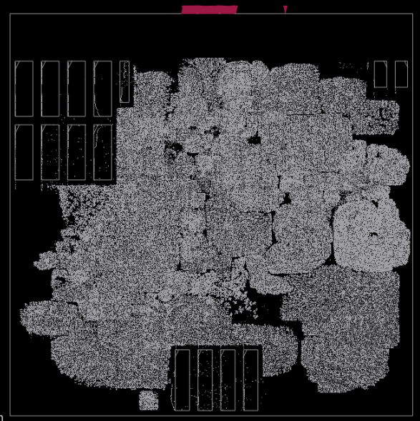
Global Placement
Notes:
THIS placement. There are around 300 thousand standard cells in this picture. The global placement gets things roughly into the right places.

Slide 21
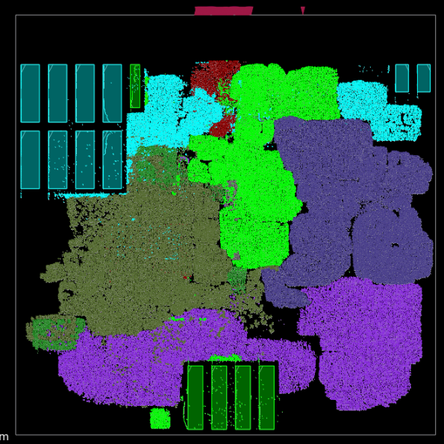
Global Placement w/Partially Expanded Hierarchy
Notes:
…. As we can see if we color according to the RTL module hierarchy. But, global placement is NOT a “legal”, well-formed placement yet. As I said, it gets standard cells into roughly good locations.
If you look closely, you’ll notice that some cells are placed on top of the memory macros, which is definitely NOT legal !

Slide 22
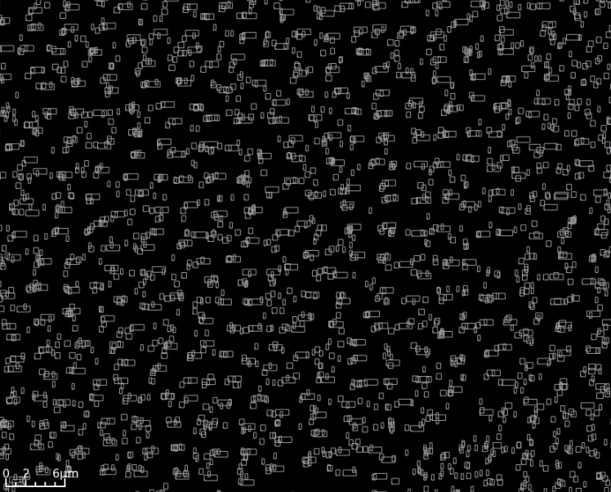
Global Placement Zoom-In
Notes:
And, if we zoom in to the global placement, you can see that cells are definitely not placed into nice rows. What’s more, even at this stage, it’s already pretty obvious where there are electrical or timing problems in this layout that we’re creating. For instance, a high-fanout net with 80 pins is going to have terrible delays and transition times at its sinks, unless we add some buffers to break up that high fanout. Or, a long net that delivers a signal from driver to a far-away receiver will need buffering as well. So, OpenROAD performs OPTIMIZATION at this juncture, including inserting buffers or upsizing weak drivers.

Slide 23
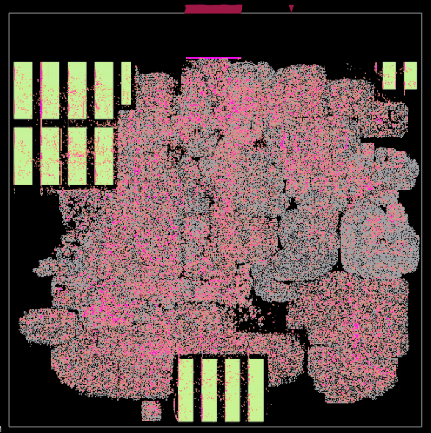
Sizing and Buffering (electrical rules)
Notes:
Sometimes, a LOT of buffers and inverters might be needed to meet maximum load or maximum transition time constraints. Here, the roughly 30,000 buffers and inverters that are added into the global placement are shown in PINK.

Slide 24
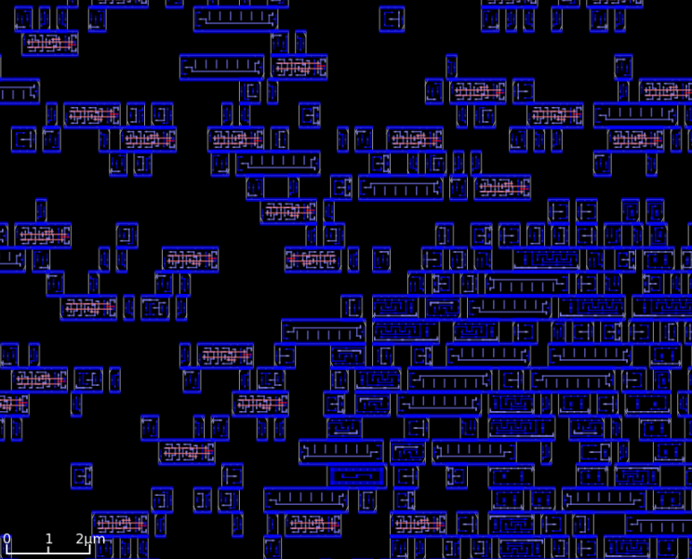
(Legalized) Detailed Placement Zoom-In
Notes:
After this, the standard-cells are LEGALIZED into rows, and users have the option to call further DETAILED PLACEMENT optimizations of wirelength or routability while maintaining the legal, row-based nature of the placement.

Slide 25
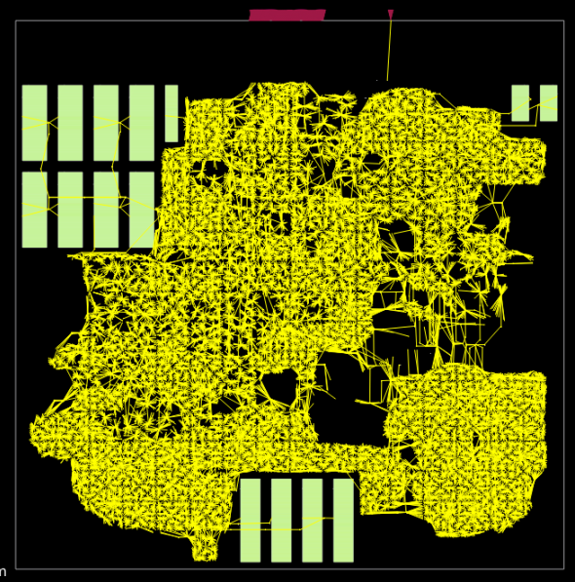
Clock Tree Synthesis
Notes:
Then, there is clock tree synthesis, where the clock signal is routed from the Clock Entry Point at the top, through a tree of clock buffers, to reach every flip-flop with low skew. There are just under 39 thousand flip-flops in this design.

Slide 26
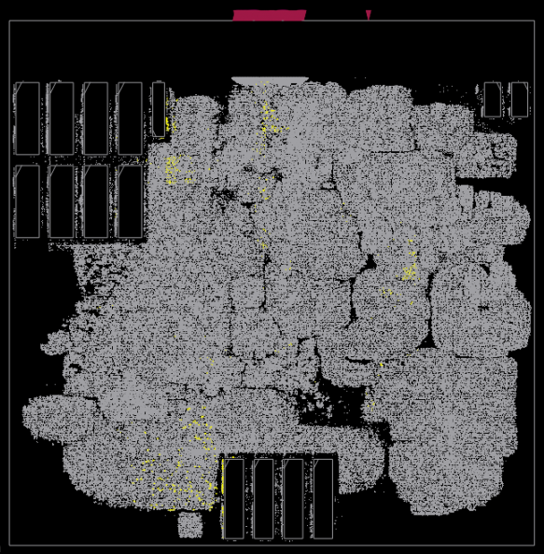
Hold Fix Buffers
Notes:
And, once we know more about the buffered clock tree topology, hold time optimizations can be performed --- that is, putting delay buffers into short combinational paths that violate hold checks.

Slide 27
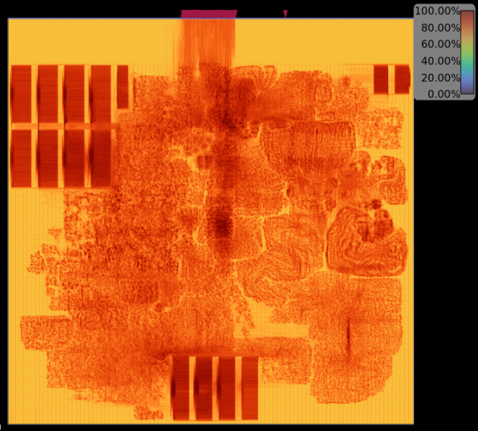
Congestion Map Is this final placement routable?
Notes:
After hold fixing and re-legalization, it’s possible to visualize routing congestion.

Slide 28
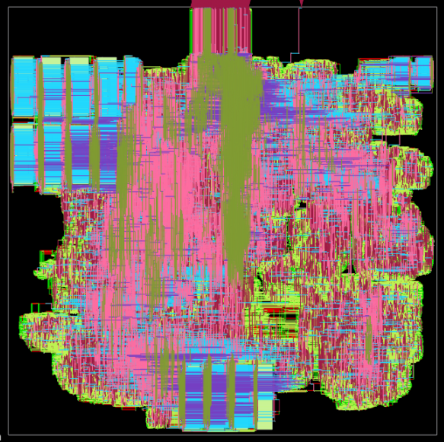
Final (Detailed) Routing
Notes:
If we go ahead with routing, here is the final result --

Slide 29
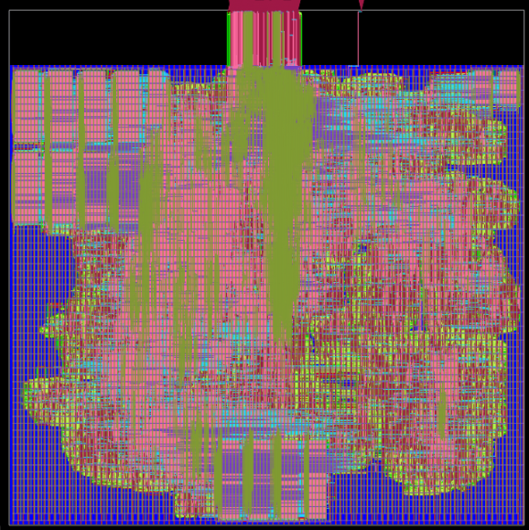
Final (Detailed) Routing, With PDN Shown
More: https://vlsicad.ucsd.edu
https://theopenroadproject.org
Notes:
--- and here is the same result with the power-ground mesh also displayed. The OpenROAD flow then goes on to perform layout finishing steps such as dummy fill insertion on metal layers, creating a merged GDS, etcetera. So, if you dig around on my lab website, for example, under “News”, you

Slide 30
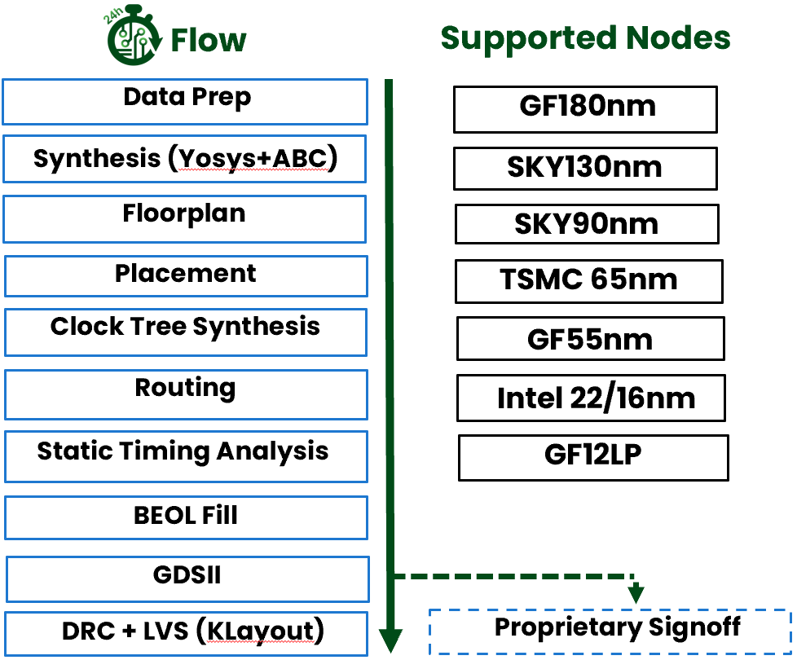
Recent Status
Functionality: 800+ tapeouts at 180-12nm
IHP130 recently supported → this class
Community: OpenROAD app has >28K commits from 130+ contributors
Education and Workforce: from high school to graduate level, extension
Researchers
Small R&D teams, startups
Notes:
OpenROAD has a uniquely successful working partnership [CLICK] of academic researchers and EDA veterans.
[CLICK] There’s been over 600 tapeouts in foundry 180nm to 12nm. With a growing community of contributors and supporters. OpenROAD supports education and outreach on many levels – Carnegie Mellon University recently blogged about their classroom use of OpenROAD, IBM just ran a faculty development program in India …
[CLICK] OpenROAD is also the basis for research in both EDA and hardware design, and it helps small R&D teams who otherwise face too many barriers to exploring system and architecture ideas.

Slide 31
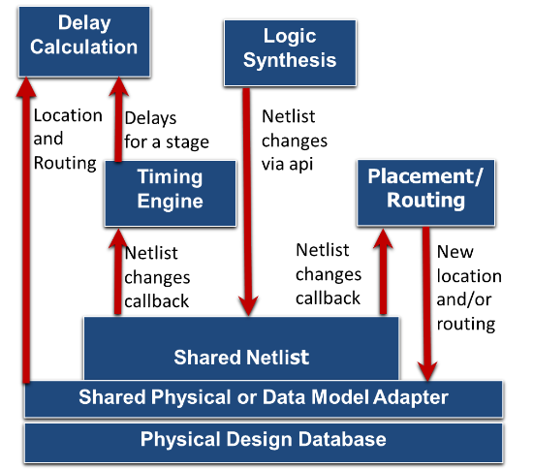
Industrial Strength Incremental Architecture: Built to Last
Further notes: link link link
Notes:
OpenROAD has the architecture of a modern EDA place-and-route tool, and it’s built to last.
This incremental Shared Netlist Architecture is the guts of commercial P&R tools since the early 2000s.
The Shared Netlist or Abstract Network Adapter enables incremental netlist modification, and communicates with Synthesis, Placement, CTS, Optimization, Routing, and the Timer. This picture shows how if Synthesis changes the netlist, then there is a callback that place-and-route is listening for – Then, if P&R changes the location or the routing, this is updated via the Shared Physical or Data Model Adapter which handles physical information such as location or routed shapes.
The timer is listening for a netlist change, and to update delays and slews, the delay calculation uses the updated location and routing information.
This architecture is what enables thousands of sizing or incremental moves per second – which is the heart of modern physical synthesis and P&R.
Starting next week, three key architects of the project will give guest lectures on internals: Matt Liberty will talk about the database; Cho Moon will talk about logic synthesis; and Tom Spyrou will talk about static timing.

Slide 32
OpenROAD Availability https://openroad.readthedocs.io/en/latest/main/README.html
The Project on GitHub
https://github.com/The-OpenROAD-Project
The Flow
Automated full flow, built using tool components that are created for automation
https://github.com/The-OpenROAD-Project/OpenROAD-flow-scripts
The Top-level Application
An integrated EDA tool focused on full automation
https://github.com/The-OpenROAD-Project/OpenROAD
More!
Documentation: https://openroad.readthedocs.io/en/latest/main/README.html
Slack: https://skywater-pdk.slack.com/archives/C0161A4A59V
OpenTapeout video: https://www.youtube.com/watch?v=wvPZREaP7E0&t=2652s
BUT: What does OpenROAD (and, OS EDA) bring to the table?
Notes:
The project is easy to find –repositories on GitHub,
[CLICK] a nicely automated flow, and
[CLICK] the integrated “app”, as we call it, which is the EDA tool. Some tutorial videos are online as well.
So, today is kind of an easy day – for me and for you. My goal is to tap-dance a bit up here and then leave you in the hands of Davit, who will introduce Lab 0.
But before that: [CLICK] why would we want to spend this quarter on Open-Source EDA? What does it bring to the table? (And, this is not about advocacy or advertising – there are many experiences, points of view and opinions on this subject. But let me give a couple of what I feel are quite a few known value propositions …)

Slide 33
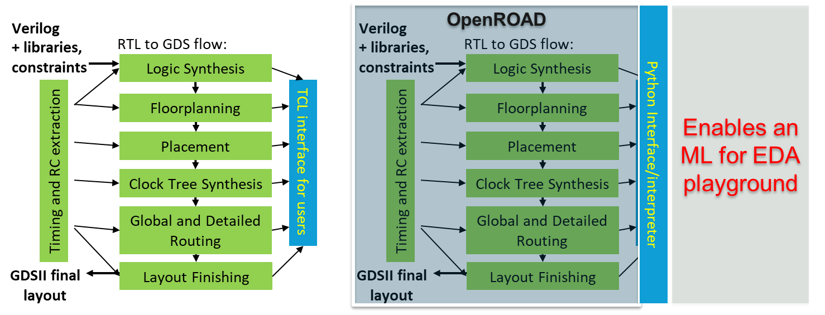
Open-source EDA Enables AI/ML for EDA, IC Design
What do designers/users work with?
What can they also
work with?
Thanks to: Prof. Vidya Chhabria, ASU
Notes:
So, these slides are from Professor Vidya Chhabria at ASU, who has worked with OpenROAD from the beginning of her Ph.D. student days at the University of Minnesota, and who is a close collaborator with NVIDIA on ML EDA. Vidya and her student are currently working on pythonization and ML-directed APIs in OpenROAD.
What everyone is familiar with is OpenROAD’s TCL interface. But OpenROAD also has [CLICK] a Python interpreter. The interpreter can run all the engines within OpenROAD except OpenSTA, as of today. So, it opens doors to users who are unfamiliar with TCL (basically, the large software community) – and it also enables a playground for ML and chip design enthusiasts who would like to explore the potential of ML algorithms in physical design.

Slide 34
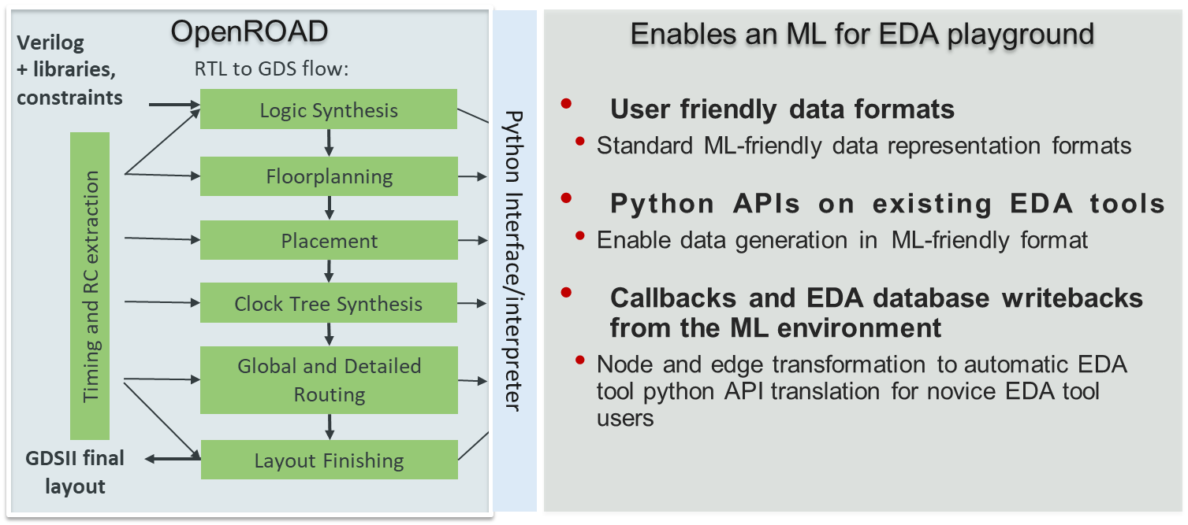
OpenROAD as an ML for EDA “Playground”
Thanks to: Prof. Vidya Chhabria, ASU
Notes:
The vision is for OpenROAD to serve as a playground for EDA researchers and the chip design community, where ML/RL algorithms integrate seamlessly and we can explore the potential of ML both within and around traditional EDA algorithms.
While some of the python APIs exist, an ML for EDA playground requires three things: (1) data representations/formats for LEF/DEF/Verilog that integrate with ML libraries; (2) additional python APIs that return information from the database in formats ML algorithms can interpret; and (3) APIs that can have callbacks from ML predictions back to the database. For example, graph-based ML algorithms that perform node and edge transformations can map back to updates to the netlist and database. What might these data formats and APIs look like?

Slide 35
Nvidia CircuitOps Data Format
ML-friendly data
representation format
Intermediate representation of EDA data as labeled property graphs (LPG) represented as deep graph library (DGL) object or graph tool which integrates easily with PyTorch
Each node has associated relational tables that store node features, e.g., pin slack, transition, etc.
V. A. Chhabria, W. Jiang, A. B. Kahng, R. Liang, H. Ren, S. S. Sapatnekar and B.-Y. Wu, "OpenROAD and CircuitOps: Infrastructure for ML EDA Research and Education", (.pdf), Proc. IEEE VLSI Test Symposium, April 2024.
Thanks to: Prof. Vidya Chhabria, ASU
Notes:
For one example: OpenROAD supports CircuitsOps format, which was proposed a couple of years ago by NVIDIA research. The format is a graph-based representation of the netlist where every edge, pin, or cell is a node in the graph with edges that connect them. Each node has annotated tables with a variety of properties (like transitions, slacks, logic functions). Having data in the form of graphs (DGL/graph tool) and tables allows easy application of GNN/GCN based algorithms, easy query of node features, and batch parallel processing with PyTorch.

Slide 36
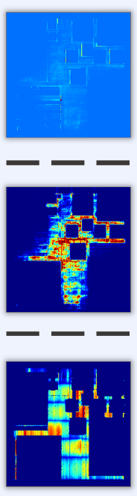
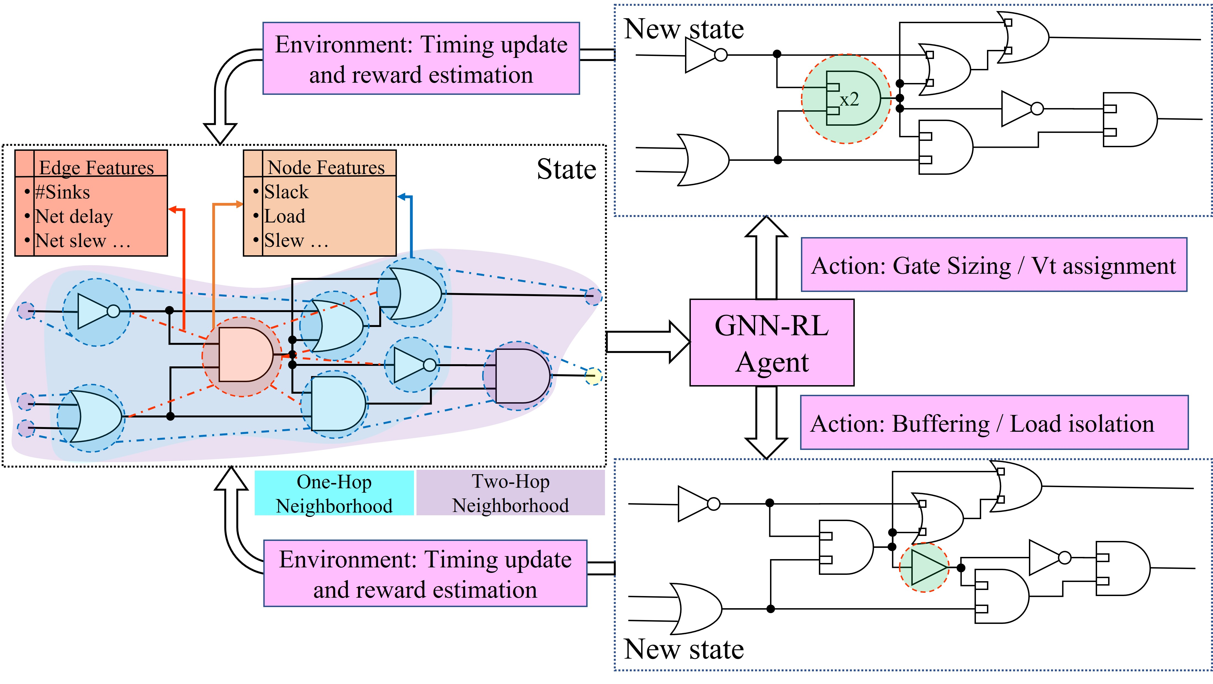
ML-centric APIs
1) all_slacks = ord.get_property(list_pins, “rise_slack”)
where all_slacks is a numpy array
2) graph_design = ord.get_netlist(list_insts, properties)
where graph_design is a DGL graph object where all nodes are instances in list_insts annotated with properties as node/edge features
3) cong_map = ord.get_map(map=congestion, resolution=1um)
where cong_map is a 2D numpy array representing a heat map
Examples of image-based ML data extraction
Congestion
Examples of graph-based data extraction: node, edge features
DRC violations
IR drop
Thanks to: Prof. Vidya Chhabria, ASU
Notes:
This slide shows example ML-centric APIs that will make the ML for EDA playground easy to “play” in. For instance, in the ML world there are GENERALLY three kinds of algorithms applied to EDA problems: graph-based, image-based, and RL-based algorithms. The APIs developed will support these algorithms and examples are shown on the slide. For instance, APIs that return the CircuitsOps graph, APIs that return congestion maps/IR drop maps as numpy arrays, and APIs that can translate transformations in the ML world back to OpenDB.

Slide 37
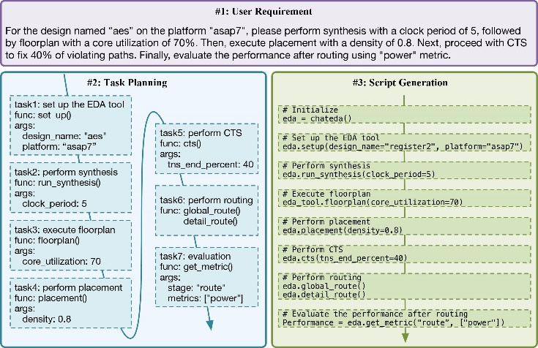
LLM-based EDA Agent: ChatEDA
#1. User Requirement
For the design named “aes” on the platform “asap7”, please perform synthesis with a clock period of 5, followed by floorplan with a core utilization of 70%. Then, execute placement with a density of 0.8. Next, proceed with CTS to fix 40% of violating paths. Finally, evaluate the performance after routing using “power” metric.
Workflow
(user) natural language input
(ChatEDA) task planning
(ChatEDA) script generation
(OpenROAD) task execution
Thanks to: Prof. Bei Yu, CUHK – see https://arxiv.org/pdf/2308.10204.pdf
Notes:
This work from the Chinese University of Hong Kong was presented at the MLCAD workshop in 2023. It develops a conversational interface for human-to-toolflow interaction, and the paper presents five example tasks that have been validated with production of working OpenROAD Tcl scripts.
Note that the research involving ChatGPT4, and the paper itself, probably couldn’t have been done with, say, an Innovus or IC Compiler that you’d work with in ECE 260B.

Slide 38
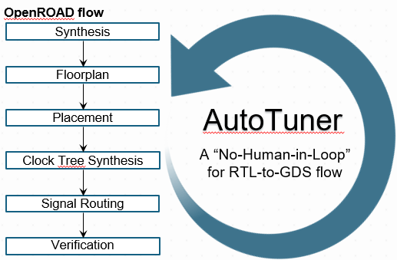
“No-Human-in-Loop” Flow Parameter Autotuning
Automatic, iterative tuning to improve user-defined score within a given hyperparameter range space
Interface: Python packages Ray/Tune
Algorithms: HyperOpt, PBT, Optuna, Nevergrad, Ax, random search
Advantages:
No need for pre-existing big data
Fewer trials needed than with, e.g., grid search
Powerful parallelization management: core/thread management, external server usage, visualization
Good outcomes within reasonable schedule, compute budgets
Notes:
Autotuning is one of the low-hanging fruits that you see commercial EDA providers offering lately – it is basically black-box optimization, or adaptive sampling – to find successful combinations of tool hyperparameters within a given budget of tool runs.
This slide is from a tutorial we gave at ASP-DAC last month. It shows that OpenROAD can be applied in conjunction with automatic tuning of flow input parameters, giving a true “No-Human-in-the-Loop” operation that achieves better quality of results than our internal expert users. The AutoTuner was deployed on Google Cloud with the help of Google engineers. We used Berkeley’s Ray/Tune, but folks have also wrapped OpenROAD for autotuning in Google’s VIZIER framework. So let me give a bit more detail about OpenROAD’s AutoTuner.
At a high level, AutoTuner is a top-level wrapper script which iteratively exercises the flow for given hyperparameter types and ranges -- to find better sets of hyperparameters.
[CLICK] It uses the Python Ray and Tune APIs, which give a powerful and easy-to-use parallelization implementation package – as well as the in-built search algorithms shown here.
[CLICK] Advantages include no need for large pre-prepared datasets. And, we find that it significantly improves tool outcomes over what our expert human users can achieve, within reasonable schedule and compute resources.

Slide 39
Flow Parameter AutoTuner – Architecture
No-Human-in-Loop
Best known parameter set
No given parameter set
option 2
parallel execution
option 1
Parameter config
input parameter name, range, step, type
AutoTuner
(Ray/Tune)
The RTL-to-GDS process is automatically executed in parallel by Ray/Tune API
Pick hyperparameter sets based on config / results
Parse picked set to form RTL-to-GDS tool runscript
Searching algorithm (switchable)
Evaluation objective function
Run runscript
Collect METRICS2.1 json
Ray/Tune options #trials, #cores, etc.
Evaluate results
Notes:
This is an architectural overview of the AutoTuner.
The AutoTuner iteratively searches for the best hyperparameter combination from given parameter configurations, to improve an evaluation objective function set by the user.
Users can set the number of threads and trials. Users can also check intermediate results through a Tensorboard GUI while AutoTuner is still running.

Slide 40
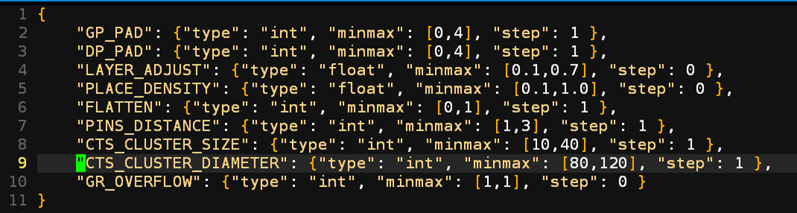
Hyperparameter Space: SkyWater 130HD, ibex
Tech: Skywater 130nm HD
Design: ibex
Tested Algorithms
HyperOpt
Hyperparameter config <name, type, minmax, step>
When type is int and step = 0, it means constant value
When type is float and step = 0, it means continuous range
Assuming full factorial combinations,
1,058,298,150 = #possible combinations!
Notes:
For a case study, we ran autotuning for the IBEX LowRISC design, using SkyWater 130HD and the HyperOpt searching algorithm.
The screenshot shows the config json taken by AutoTuner: It includes the input hyperparameters’ type, range, and step size. You can see that
[CLICK] The total possible number of combinations in this parameter space is over a billion!
And humans are smart, but it is not easy to predict how different combinations will change the outcome of the full RTL-to-GDS flow.

Slide 41
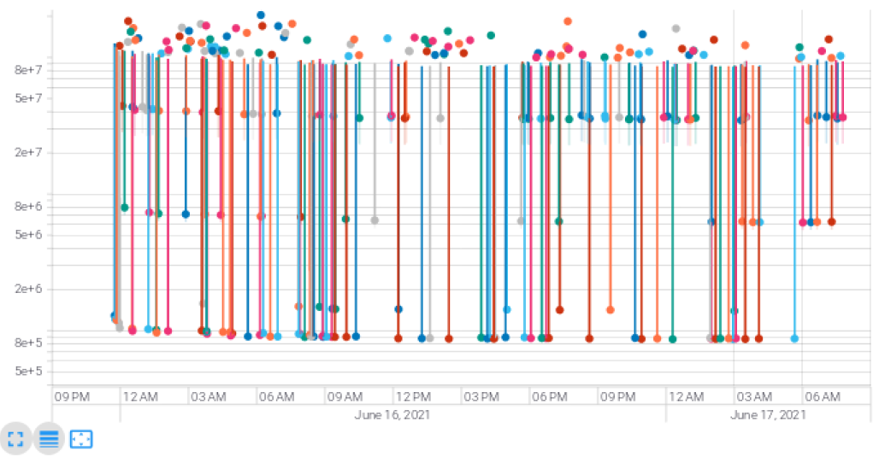
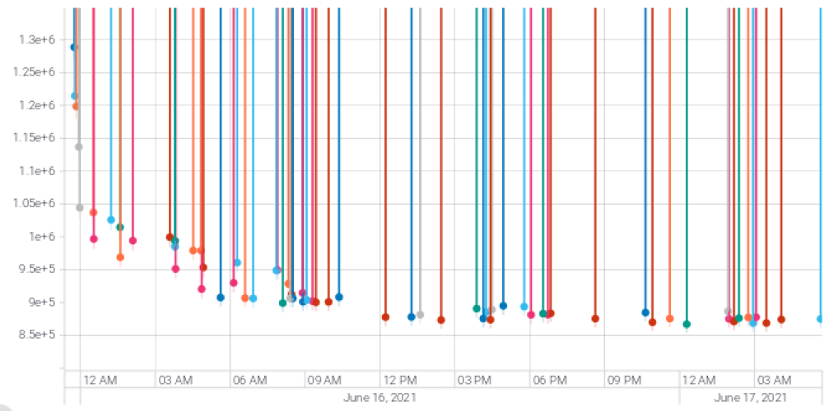
TensorBoard Visualization: SkyWater 130HD, ibex
GUI integration with TensorBoard
Score results versus Wall Time
User-defined
Score
Dots = trials
Default flow score = 1,174,346 Our Best Score = 855,373
(370 trials in total 500 #trials)
(less is better)
Improvement
WL 1003801um → 843258um (-16%)
Effective CP 20.935ns → 16.185 ns (-23%)
Total power 0.024 W→ 0.0133 W (-45%)
Wall Time
Notes:
The AutoTuner stores Tensorboard logs in real time and allows users to observe progress through the GUI at any time.
For this case study, we set a limit of 500 trials, and the 370th trial achieved the best results.
Without changing utilization or timing constraint, there are still significant improvements.
The [CLICK] lower right box shows the QoR difference between the previous, manually-determined flow options found by the OpenROAD project team, and the flow options found automatically by AutoTuner. This is actually a 4 year old result – OpenROAD AutoTuner was developed by a postdoc at UCSD and released in 2021.

Slide 42
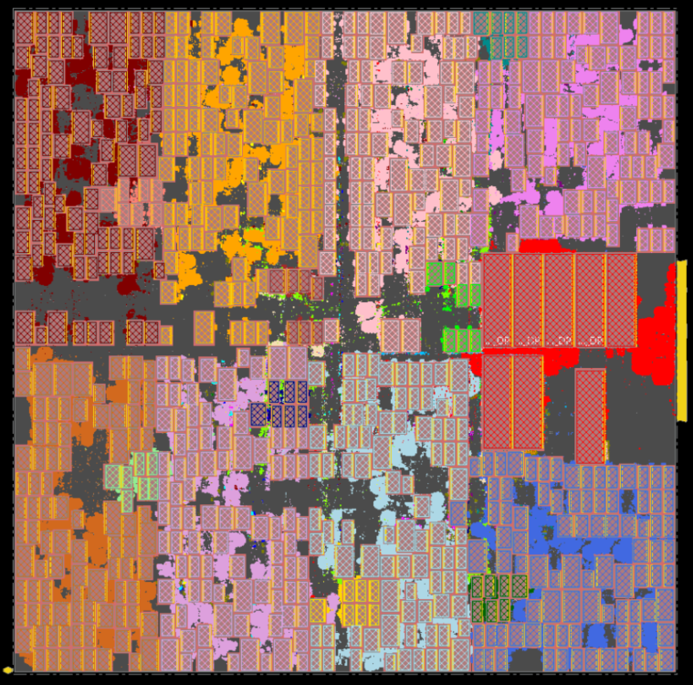
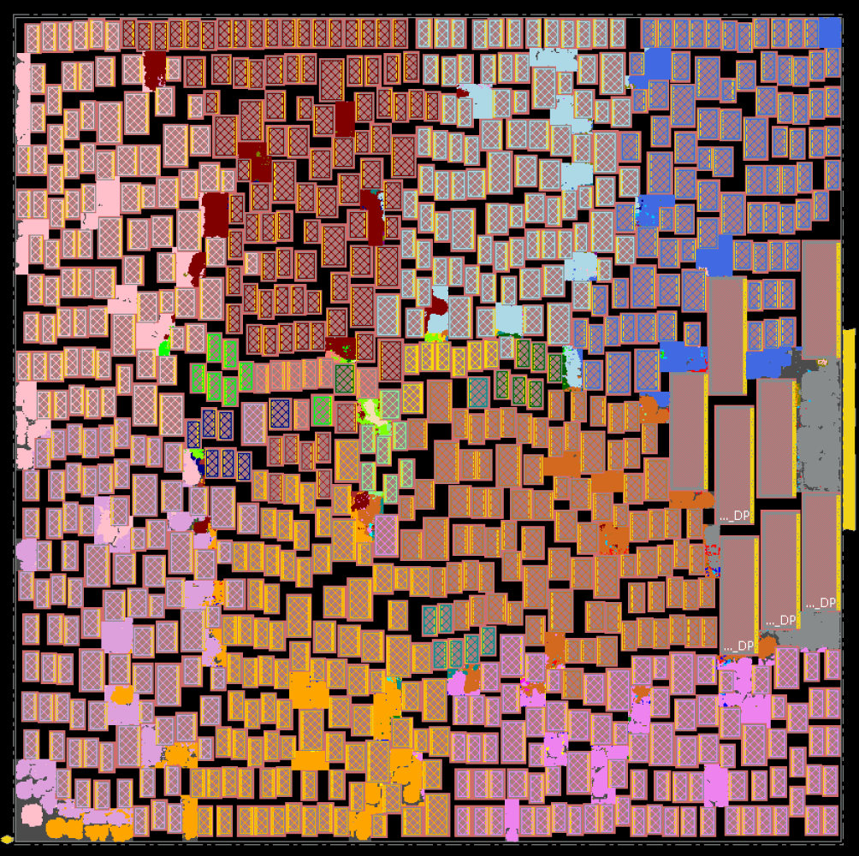
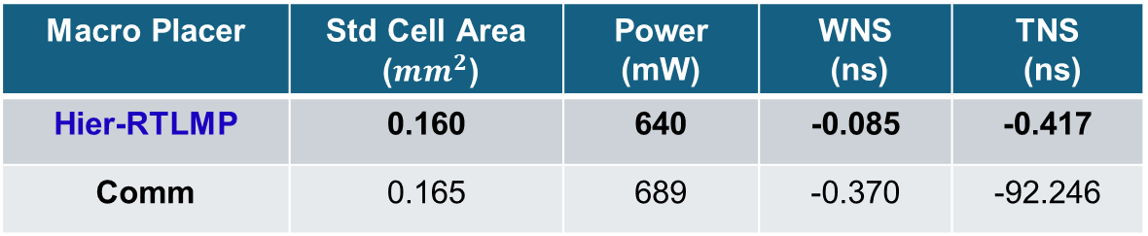
High-quality Engines: Hier-RTLMP Macro Placer
TABLA01 AI accelerator in GF 12nm, 760 macros
Hier-RTLMP (postRoute)
Comm Macro Placer (postRoute)
Macro Placer | Std Cell Area (${mm}^{2}$) | Power (mW) | WNS (ns) | TNS (ns)
Hier-RTLMP | 0.160 | 640 | -0.085 | -0.417
Comm | 0.165 | 689 | -0.370 | -92.246
OpenROAD tool GitHub (/src/mpl2) , arXiv
Notes:
OpenROAD is also where you can see some One theme for optimization and ML is to enable faster and more accurate exploration of hardware architecture and chip floorplan options. We want to shorten the time to useful timing, power and area feedback. Hierarchical RTL-MP understands RTL hierarchy and dataflow, and delivers human expert-like results.
For this testcase with 760 macros, it dominates a commercial tool’s macro placer – see the area, power and timing results in BOLD – when evaluated apples-to-apples by completing the remaining place-and-route flow with Cadence’s Innovus tool.
[CLICK] The code is integrated with OpenROAD and available on GitHub.
https://arxiv.org/abs/2304.11761
https://github.com/The-OpenROAD-Project/OpenROAD/tree/master/src/mpl2

Slide 43
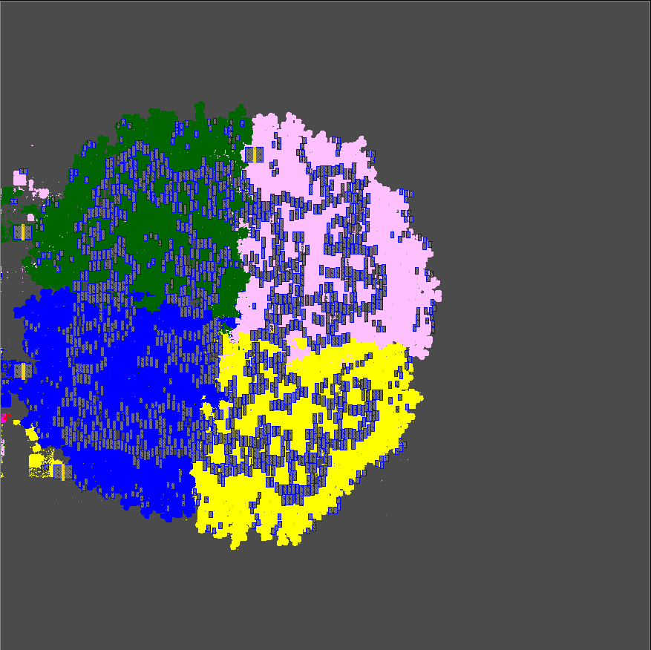
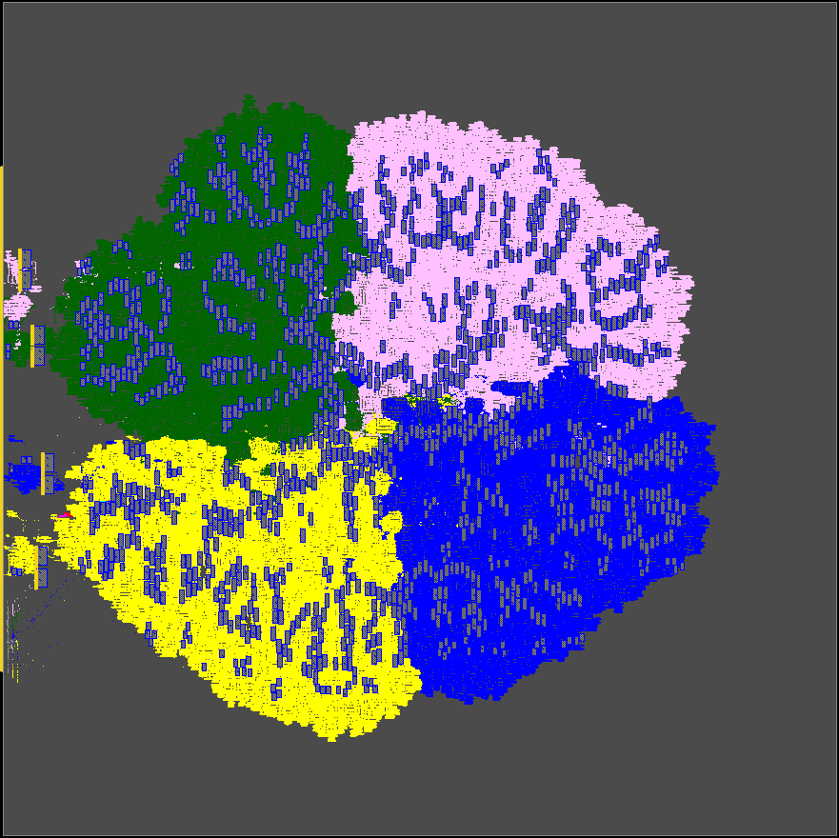
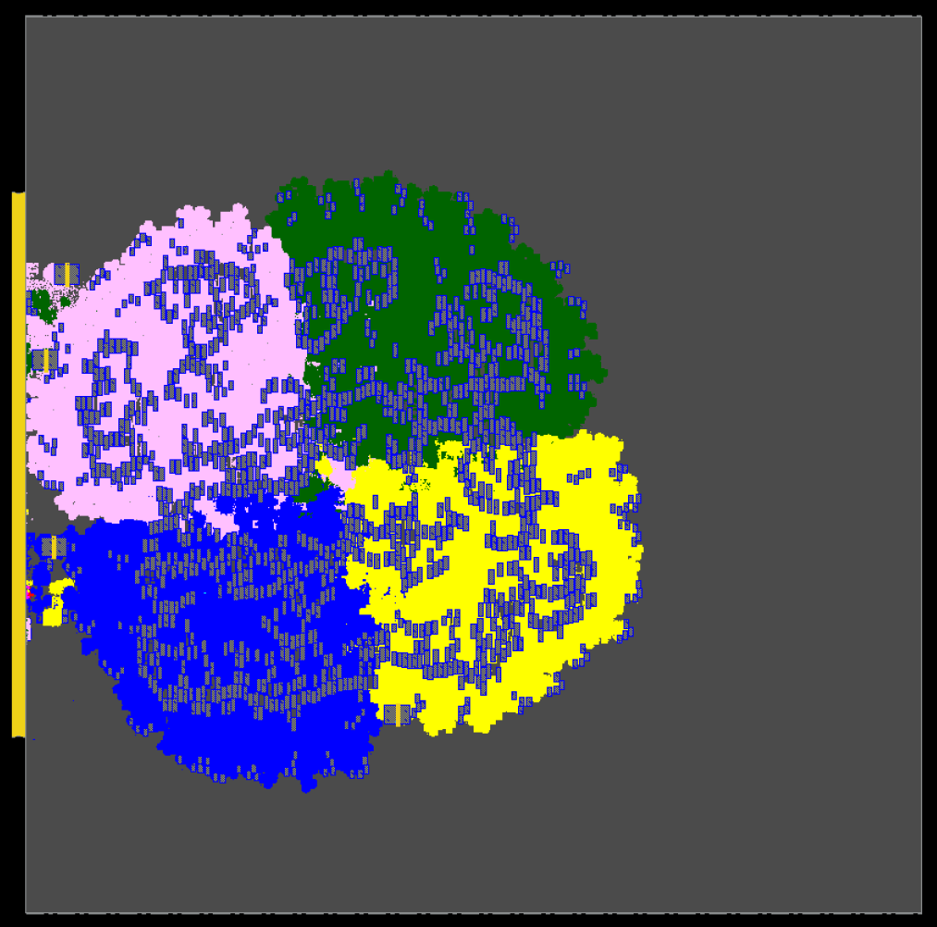
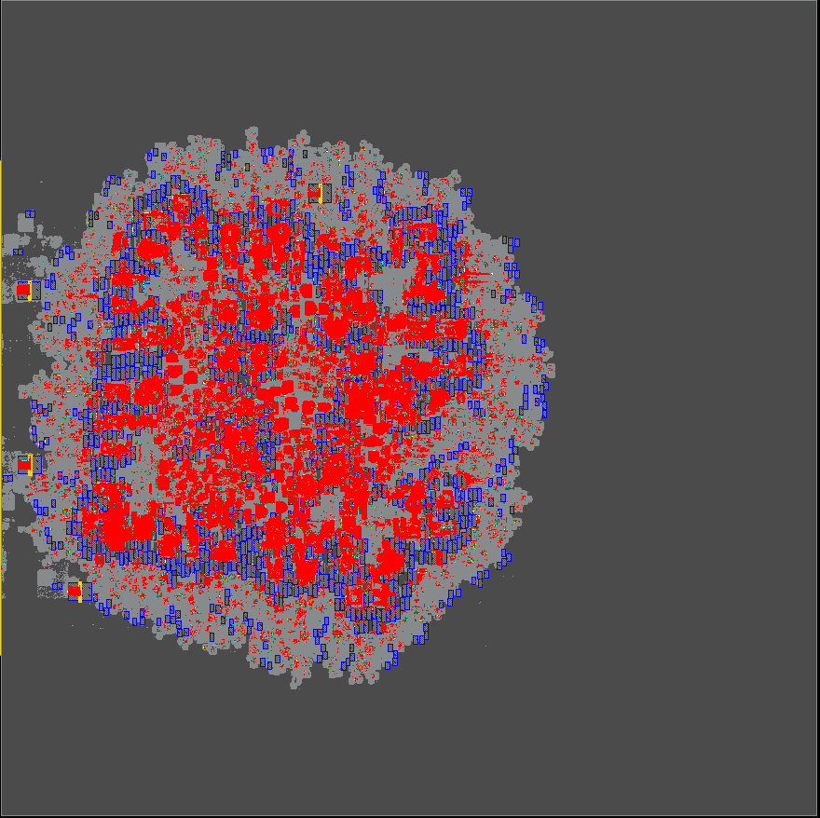
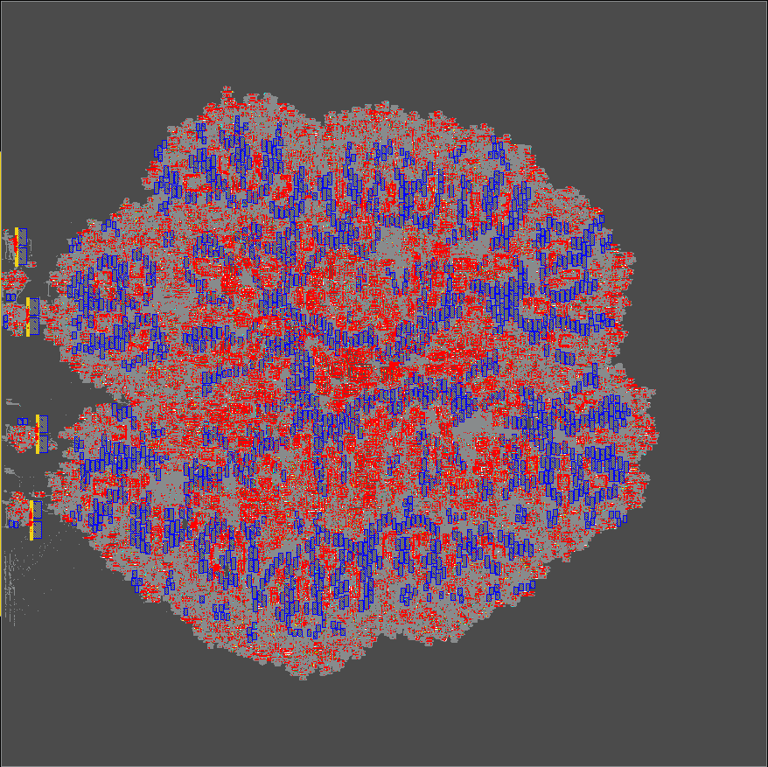
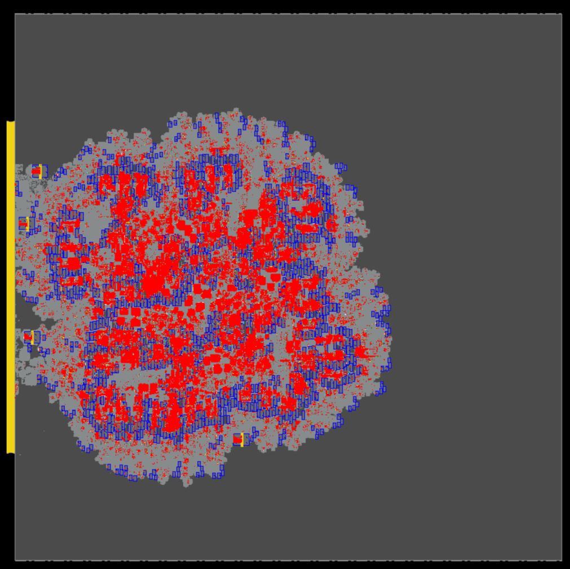
High-quality Engines: GPU-Accelerated Global Placer
Runtime (s) HPWL (m) eGR WL (m)
RePlAce 65381 325 404
Comm 24561 414 478
DG-RePlAce 1808 327 407
OpenROAD RePlAce
Commercial
DG-RePlAce
2.79% H + 2.04% V
1.51% H + 1.01% V
2.37% H + 1.68% V
Testcase: MemPool Cluster, ETH Zurich (9.5M cells, 1296 macros in NG45)
Notes:
We know that EDA algorithms must leverage paradigms like parallel, GPU, and cloud to reduce design time and effort.
So, for example, GPU-accelerated EDA has been a hot topic in recent academic research, with groups such as Evangeline Young’s lab at the Chinese University of Hong Kong really doing great work.
[CLICK]
At the same time, classical electrostatic-based global placers like OpenROAD’s RePlAce miss the global view of the design.
Here are runtimes and wirelengths for RePlAce, and an UNNAMED Commercial placer. The eGR Early Global Route wirelength is measured by Cadence Innovus. This is again the MemPool Cluster RISC-V design with more than 9 million cells and nearly 1300 macros. RePlAce takes 18 hours to place this testcase, and the Commercial placer takes about 7 hours.
[CLICK] Here is the output of a new placer which is GPU-accelerated and follows a mindset of connecting from abstraction to implementation via clustering guidance. It runs in half an hour,
[CLICK] with reasonable congestion. So, faster, better and scalable. We can certainly wrap learning and search around this, for architecture, RTL and floorplan exploration.

Slide 44
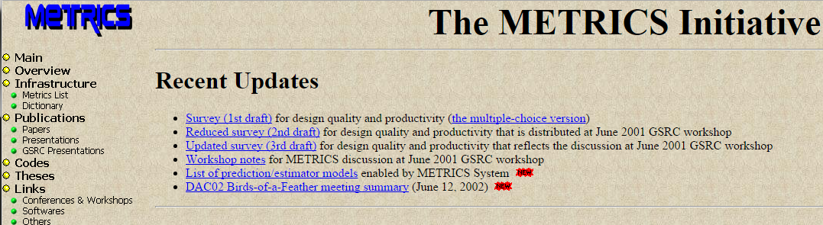
“METRICS” (DAC00, ISQED01)
METRICS 1.0 (1999; DAC00, ISQED01)
“Measure to Improve” http://vlsicad.ucsd.edu/GSRC/metrics
METRICS 2.0 (WOSET-2018) was proposed as an update of METRICS 1.0
METRICS2.1 is proposed as a standard, with a concrete realization in OpenROAD
Notes:
Again in collaboration with IEEE CEDA, we have published large-scale metrics datasets harvested from thousands of runs of the OpenROAD design flow, to stimulate data collection and publication that we hope will enable machine learning research.
The METRICS initiative in the late 1990s proposed to measure all design activity, mine data, predict tool outcomes and find design-specific tuning and fields of use for a given tool.
Nearly 20 years later, METRICS2.0 revisited metrics and proposed an updated architecture for collecting and sharing of big data for Machine Learning in IC design and EDA.
Now, METRICS2.1 is a recent proposed extension that formalizes METRICS syntax and gives an OpenROAD-based realization, plus public repos of metrics data for visualization and ML applications.

Slide 45
METRICS2.1: Standard Naming ! https://github.com/ieee-ceda-datc/datc-rdf-Metrics4ML
Problem: “Tower of Babel” (names, formats that are all different and proprietary)
Solution: “METRICS”
General and extensible
Syntax and semantics to support future addition of new metrics
No ambiguity!!!
Any desired measurement must map to a unique METRICS2.1 metric
Every METRICS2.1 metric must map to a unique interpretation as a measurement
Two-way mapping is crucial to avoid future confusion
Can also capture the same metric at different stages of the design flow
Free, open and frictionless – agnostic to EDA provider
Notes:
METRICS2.1 wants to be simple, general and extensible in its syntax and semantics. We want to cure today’s Tower of Babel where there is no agreed definition and term for overcongestion or crosstalk delay or other metrics.
A guiding precept is that (1) any desired measurement must map to a unique METRICS2.1 metric and (2) every METRICS2.1 metric must map to unique interpretation as a measurement and should be intuitively obvious to users.
This two-way mapping is also important to avoid the “Tower of Babel” situation. Also: In a typical design flow, the value of a specific metric changes at different stages in the flow and we want to be able to capture the same metric at different stages.

Slide 46
METRICS2.1 Examples https://github.com/ieee-ceda-datc/datc-rdf-Metrics4ML
Sample metrics
Metric | Description
timing__setup__wns | Setup worst negative slack in the design
timing__setup__wns__clock:clk_a | Setup worst negative slack for clock “clk_a” in the design
timing__setup__wns__analysis_view:slow | Setup worst negative slack for analysis view “slow”
power_total | Total power consumption
power__leakage | Total leakage power
power__leakage__clock | Total leakage power in the clock network
Many applications: data for machine learning, CI/CD infrastructure for software quality, …
Notes:
Here are some example METRICS2.1 metrics and their interpretation. The current METRICS dictionary and naming conventions are all visible in the GitHub repo here.

Slide 47
A Comment on SP25 Classes
ECE 260C (Special Topics): focus is on RTL-to-GDS implementation with open-source enablement (EDA, PDK, Design)
See and modify what is inside the EDA tool; use OS lever to improve outcomes
CSE 241A (cross-listed with ECE 260B): “classic” 260B/241A with commercial EDA tools
“Job-readiness” in ASIC PD + what/how tools think inside, with more CSE flavor
CSE 291 H00 “Topics in ML for Chip Design”: AI/ML in EDA and IC Design
Must use open source to explore AI/ML ! → similar tool, flow context as 260C
ECE 260C
CSE 241A
PPAC- driven
Closed Source
IC PD
Open Source
AI/ML in EDA
CSE 291
Notes:
Last, you might have noticed that after this class I will be walking back to the CSE building and having a couple of other classes – are there common elements, how do these classes differ, and so on …
So, in case helpful, here is my take on that …..

